Slide 1
Partnership During a Pandemic
Sovereignty Government to Government Shared Responsibility
Tribes and Washington State

Slide 2
“Alone we can do so little; together we can do so much.” Hellen Keller

Slide 3
Tribal-State Partnership
Weekly State Agency Tribal Liaison Meetings

Slide 4
Tribal-State Partnership
Washington State Department of Health (DOH)
Tribal Liaison Officer Position
State Health Officer and State Epidemiologist for Communicable Diseases Met with Tribes, February 19
Weekly Tribal and Local Health Officers Meetings
Joint AIHC-DOH Training Webinars
Access to Data

Slide 5
Tribal-State Partnership
Washington State Health Care Authority (HCA)
Zoom licenses for telehealth
Loaner laptops for telehealth
Loaner cell phones for patients to access telehealth
Loaner laptops for mobile testing

Slide 6
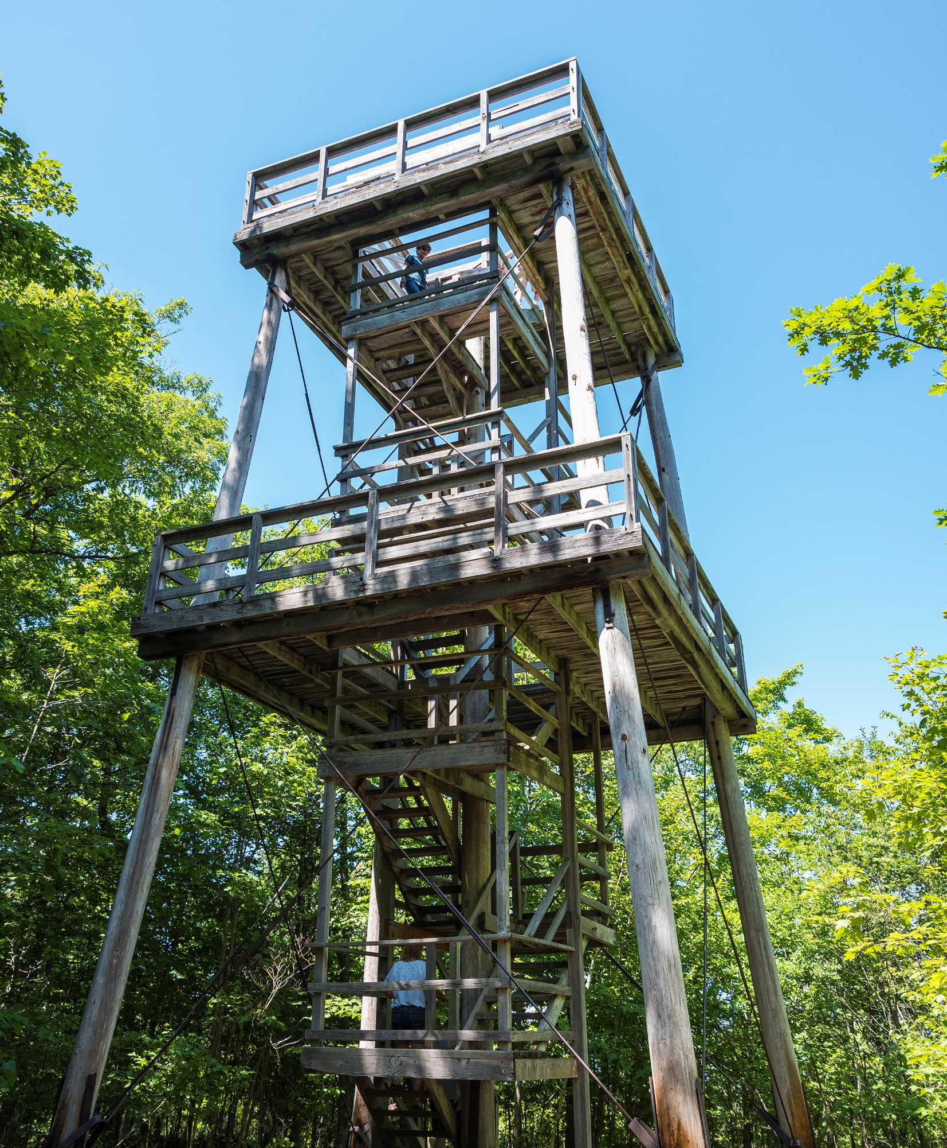
Tribal-State Partnership
Washington State Department of Natural Resources
Offered up DNR tower to Tribe for temporary internet access

Slide 7
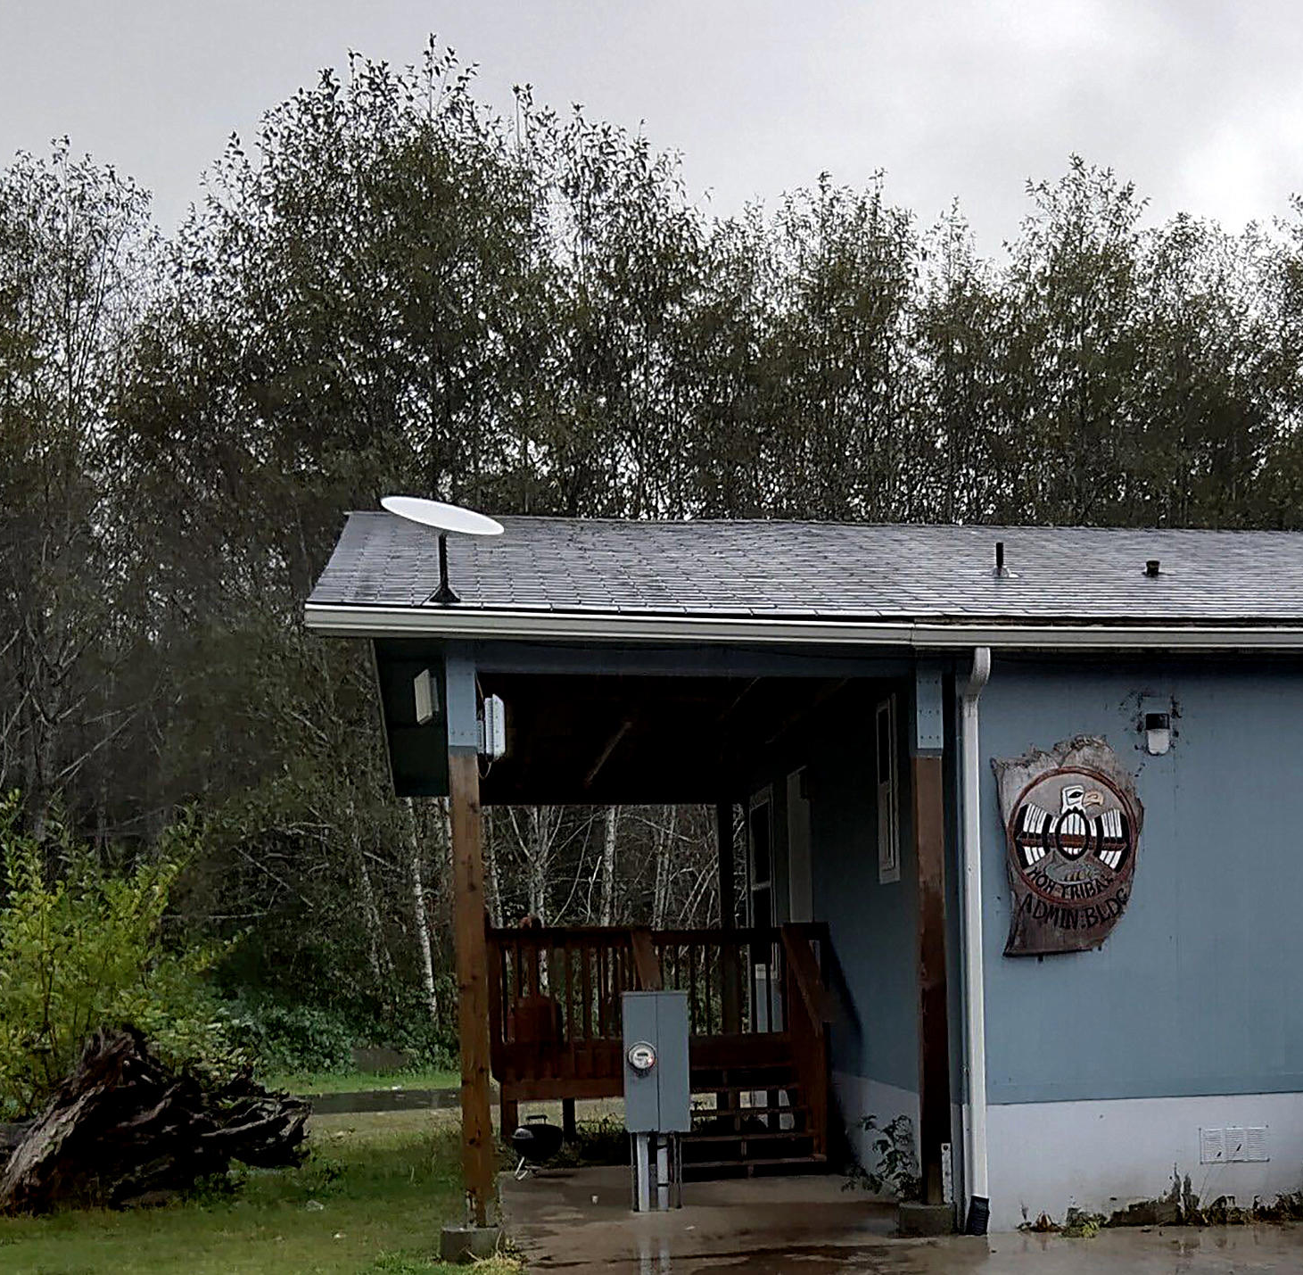
Tribal-State Partnership
Washington State Department of
Commerce
Broadband Access
Tribal Funding Distribution

Slide 8
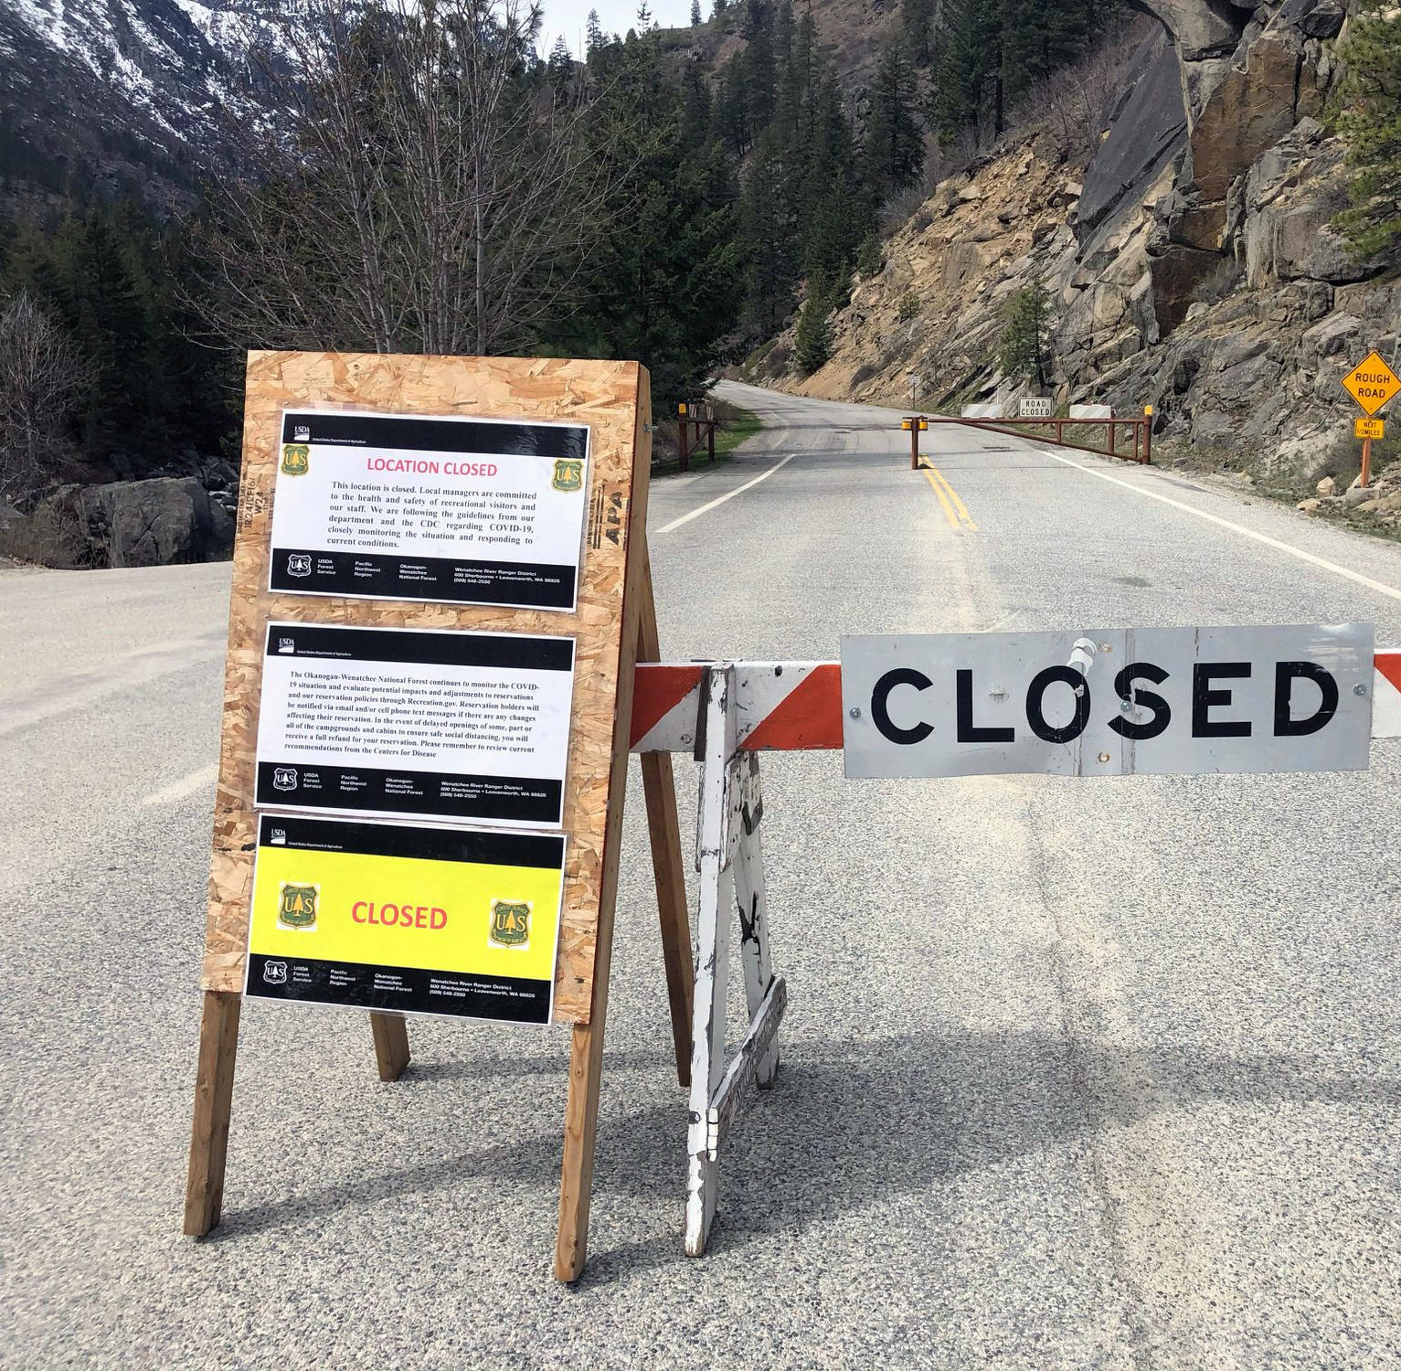
Tribal-State Partnership
Department of Transportation
Barricades
Signage

Slide 9
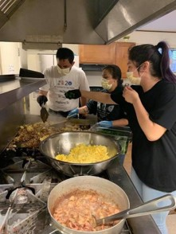
Tribal-State Partnership
Washington State Department of Agriculture
Compiled list of food resources for Tribes
Addressed individual Tribes’ urgent needs
Provided food for tribal food pantries
Provided food for children schooling at home

Slide 10
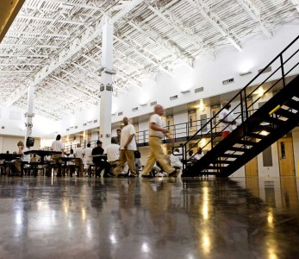
Tribal-State Partnership
Department of Corrections
Weekly updates

