Slide 1
DCYF Centennial Accord Updates
Sally Brownfield, Squaxin Island Tribe, Education Director, IPEL Chair
Loni Greninger, Jamestown S’Klallam Tribe Vice-Chair
Ross Hunter, Secretary DCYF
Notes:
AGENDA
Early Learning Strategic plan
RESJ
Secretary’s List
Certificate of Parental Improvement
Z.J.G.

Slide 2
ECEAP Services Throughout the Pandemic
Increased Resources for Children and Families
Increased Visits with Families
Increased Online Supports
In-Person Services
Notes:
Refer to: Non-Traditional/Modified Services in ECEAP During COVID-19 https://dcyf.wa.gov/sites/default/files/pdf/ECEAP_NonTraditional_Modified_Services_COVID19.pdf

Slide 3
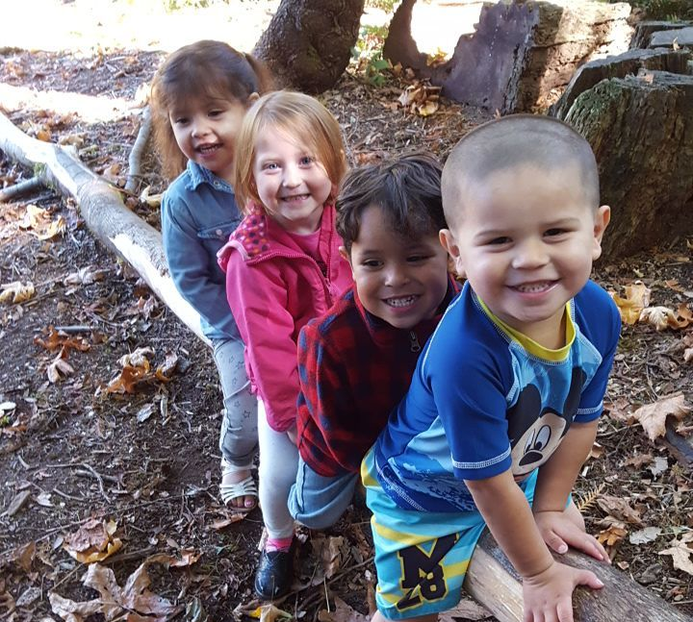
Early Learning
Notes:
https://www.youtube.com/watch?v=jjH5-CQUqJY

Slide 4
Z.J.G. Supreme Court Decision
On Sept. 3, 2020, the Washington State Supreme Court issued an opinion in In re Dependency of Z.J.G. and M.E.J.G., holding that a court has a “reason to know” that a child is or may be an Indian Child when a participant in the proceeding indicates that the child has tribal heritage.
This change in when a court has a “reason to know” a child is Indian will require DCYF to make changes to its practice and policy.
Notes:
Please refer to handout for more details
The Court’s opinion expands the “reason to know” standard that triggers the Indian Child Welfare Act (ICWA) and Washington Indian Child Welfare Act’s (WICWA) application.
The Supreme Court’s decision clarifies that if there is any indication from any participant that a child has Indian heritage — for example, testimony from a social worker, parent or intervening tribe — the Acts’ protections must be applied.
DCYF is submitting a decision package to address current gaps in services and programs.
DCYF will begin making policy revisions through the ICW Subcommittee in early 2021.
DCYF will work to develop process maps of the current Qualified Expert Witness and legal notice systems to address needed changes.

Slide 5
Thank you!
Contact:
Ross Hunter
Secretary
Ross.hunter@dcyf.wa.gov

