Slide 1

Health Planning Session
Outcomes for 2020 Centennial Accord
November 19, 2020

Slide 2
Ensuring Agencies are Treating Tribes as Government
Tribal Sovereignty

Slide 3
Tribal Jurisdiction and Authority
Tribes possess the inherent sovereign authority to provide services for their community members including, but not limited to: public health services, preventative services, inpatient treatment, and involuntary commitment proceedings through their tribal courts.

Slide 4
Tribal Jurisdiction and Authority
Tribal nations have inherent sovereignty over both their members and their territory. United States v. Mazurie, 419 U.S. 544, 557 (1995).
The sovereignty retained by Tribes includes “the power of regulating their internal and social relations,” United State v. Wheeler, 435 U.S. 313,322 (1978).

Slide 5
Tribal Jurisdiction and PL 280
PL 280 does not remove a Tribe’s sovereign authority. Bryan v. Itasca Cnty, 426 U.S. 373.
PL 280 does not grant authority to states to regulate civil activities in Indian country. Bryan v. Itasca Cnty, 426 U.S. 373.
PL 280 did not remove the criminal or civil jurisdiction of tribal courts over activities in Indian country, but rather provided concurrent jurisdiction with state courts. Walker v. Rushing, 898 F.2d 672, 675 (8th Cir. 1990).
Notes:
or further reading on PL 280, see Professor Carole Goldberg’s, Questions and Answers about Public Law 280, at http://www.tribalinstitute.org/articles/goldberg.htm, and Professor Robert T. Anderson’s article, Negotiating Jurisdiction: Retroceding State Authority Over Indian Country Granted By Public Law 280,” Wash. L. Rev. 87, 915 (2012).

Slide 6
Tribal Jurisdiction and PL 280
The Washington State Supreme Court has reached the same conclusion in State v. Schmuck, 121 Wash. 2d 373(1993): “In the area of civil regulatory authority, the United States Supreme Court observed that nothing in the text of Public Law 280 addresses the removal of tribal authority, as would be expected if Congress intended such a ‘sweeping change in the status of tribal Government.’ ” Citing to Bryan, 426 U.S. at 381.
Notes:
or further reading on PL 280, see Professor Carole Goldberg’s, Questions and Answers about Public Law 280, at http://www.tribalinstitute.org/articles/goldberg.htm, and Professor Robert T. Anderson’s article, Negotiating Jurisdiction: Retroceding State Authority Over Indian Country Granted By Public Law 280,” Wash. L. Rev. 87, 915 (2012).

Slide 7
2019 Centennial Accord Health Issues
Addressing issues with the Behavioral Health Crisis System
Support of Funding Foundational Public Health Services
Opioid Response
Tribal Data
IHCP Workforce Development
Continue funding and coordination for Tribal Youth Prevention Programs
Ensuring Agencies are Treating Tribes as Government

Slide 8
2020 Accomplishments
Governor’s Indian Health Advisory Council – provided advisory role in state legislation:
  Indian Behavioral Health Act
  The Long-Term Services and Support Act
Passage of the Indian Behavioral Health Act
Washington Tribal and UIHP COVID-19 Response that Received National Recognition

Slide 9
Addressing Issues in the Behavioral Health System
Passage of Indian behavioral health Act

Slide 10
Overview of the Indian Behavioral Health Act
Passage of SSB 6259- the Indian Behavioral Health Act in Washington State March 2020 made the following changes to the crisis system:
Requires Tribal Court Orders for ITA are recognized and honored
Allows Tribes to file and/or intervene in ITA Court proceedings
Requires notification of IHCP of ITA proceeds for Tribal Member/Citizen
Allows IHCP and Tribal Courts to receive mental health records
Established Tribal DCR
  Appointed through a process with HCA and Tribe
  Paid by the HCA to the Tribe for ITA services (*in development)

Slide 11
Support of Funding Foundational Public Health Services
Funding Tribal Foundational Public health services

Slide 12

MATERNAL - INFANT HEALTH SERVICES
Notes:
The state definitions didn’t readily translate into foundational public health services at Tribes and UIHOs. Last December 2019, AIHC held a Tribal FPHS Summit to get input from the Tribes on Tribal FPHS programs/ definitions. This allows for the TFPHS to be tribally driven, instead of always trying to assimilate into the State’s definition.

Slide 13
Tribal Youth Prevention Programs
Ensuring funding for the work

Slide 14
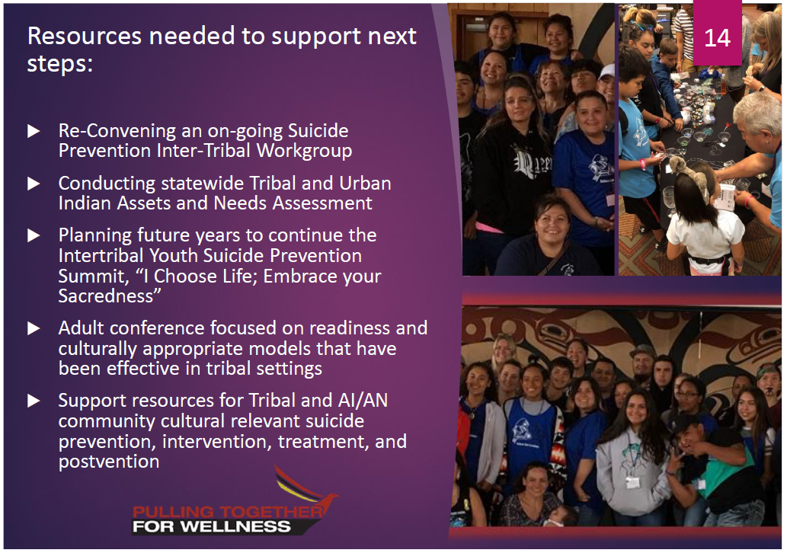





Slide 15
Tribal Data Soveriegnty

Slide 16

Issues
Tribes and UIHPs need additional health data technology systems and infrastructure to adequately manage their public health data
Tribes and UIHPs need increased access to Washington State information systems that include data related to the health of AI/ANs and tribal communities
State (and federal) data systems are used for allocating funds and planning programs, but they include incomplete and inaccurate data on AI/AN due to misclassification and underreporting
Tribal sovereignty must be respected so Tribes can control the collection, reporting, and use of their data

Slide 17
Work Completed
Facilitated access to Tribes and UIHPs to state public health databases
  RHINO (Washington Rapid Health Information Network)
  WDRS (Washington Disease Reporting System)
Worked with DOH to develop 29 reports in WDRS for COVID cases
Working with Tribal Data Sovereignty Workgroup to expand access to state data systems
Seeking resources to acquire population health information management systems for Tribes and UIHPs

Slide 18
Next Steps
Continue Tribal Data Sovereignty Workgroup
  Expand access to state data systems
  Build on Tribal data capabilities
Identify resources for investment in tribal and UIHP information systems technology, infrastructure and workforce development to strengthen tribal public health data management capabilities
Develop legal mechanisms and administrative policies and procedures to assure protection of tribal data in tribal information systems and non-tribal information systems
What else?

Slide 19
IHPC Workforce Development
CHAP and other providers

Slide 20
Community Health Aids, Behavioral Health Aids and Dental Health Aid Therapist
Community Health Aids (CHA,) Behavioral Health Aids (BHA) and Dental Health Aid Therapists (DHAT) can fill a gap in workforce at Tribes.
Services provided by these provider types need to be billable under the Medicaid program
We believe there are already similar certified providers that show these provider types just need to have a certification process with the state developed in order for payment to happen:
BHA same/similar to Peer Counselors, same training.
Authorized provider for maternity support services

Slide 21
2020 Centennial Accord Health Issues
COVID-19 Impact on Budgets and Workforce
Equitable Distribution of
Appropriate COVID-19 Vaccines

