Slide 1
Targeted Efforts and Identified Future Goals
A Presentation to GTLSSC on Reentry 2030, Substance Use Disorder Response
Cheryl Strange, Secretary
October 30, 2023

Slide 2
Governor’s Call to Action Reentry 2030
DOC represented at the Health Services Sub-Cabinet
Support and funding for other agencies to prioritize those reentering
Increase affordable housing
Increase jobs for formerly incarcerated and increase job readiness
Create immediate access to substance abuse and MH treatment in the community
HCA 1115 Waiver – access to Medicaid prior to release
Third in the Nation to sign onto Reentry 2030
Notes:
WA DOC was the third state in the nation (Missouri was first, Arkansas second) to sign onto Reentry 2030 and as part of that, we are working with the Governor’s office and our partner organizations to revise Governor Inslee’s 2016 executive order
Reentry 2030 vision is a national initiative that aims to dramatically improve reentry success for people exiting prison and those under supervision.
We are committed to a future of reentry that is:
In 2023: Policy guidance for scaling up access to reentry supports, clearing away unnecessary barriers, and advancing racial equity Roundtable discussion on envisioning human-centered reentry systems. Peer learning opportunities for state reentry directors

Slide 3
Reentry Partnerships are Critical
State Boards & Councils
CI Advisory Committee
Separately Elected
State Agencies
Dept of Children, Youth, & Families
Dept of Commerce
Dept of Ecology
Dept of Health
Dept of Licensing
Dept of Social & Health Services
Dept of Transportation
Employment Security Dept
Health Care Authority
WA Dept of Veterans Affairs
Washington Student Achievement Council (WSAC)
Indeterminate Sentence Review Board
State Board of Technical & Community Colleges
Statewide Family Council
Statewide Reentry Council
Federal Partners
Community Partnerships
Aerospace Joint Apprenticeship Committee (AJAC)
Community Colleges & Four-Year Universities
Non-profit Partnerships
Labor Unions
Social Security Administration
Labor & Industries
U.S. Department of Veterans Affairs
Secretary of State
Department of Natural Resources
Tribal Governments

Slide 4
Substance Use Disorder Redesign
2024 Supplemental Request
$8.5 Million – for Medications for Opioid Use Disorders (MOUD)
1 Lead ASAM certified Addiction Medicine Physician
1 MOUD Treatment Administrator
3 MOUD Coordinators
22 Nurse 2s
1 MOUD Nursing Supervisor
14 Custody Officers to provide supervision while dosing.
Sublocade funding for 29 doses (approximately $1,500 per dose) in FY2024
$4.5 Million Total - Reentry Services and Supports Total DP. Includes investments in coordination of transition for those with SUD needs.
8 Recovery Care Navigators
1 SUD Linkage Supervisor

Slide 5
Substance Use Disorder Redesign
2025-2027 Biennium
Key Components:
Expansion of Patient Centered Medical Home
Implementation of the federal 1115 waiver
Redesign of Reentry Centers

Slide 6
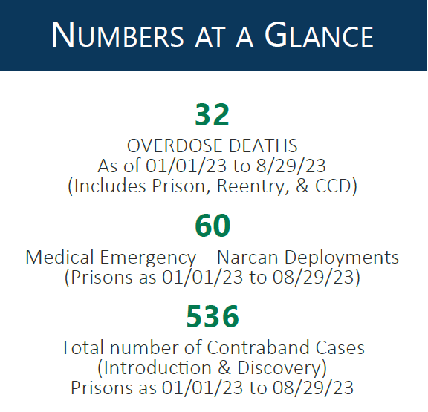
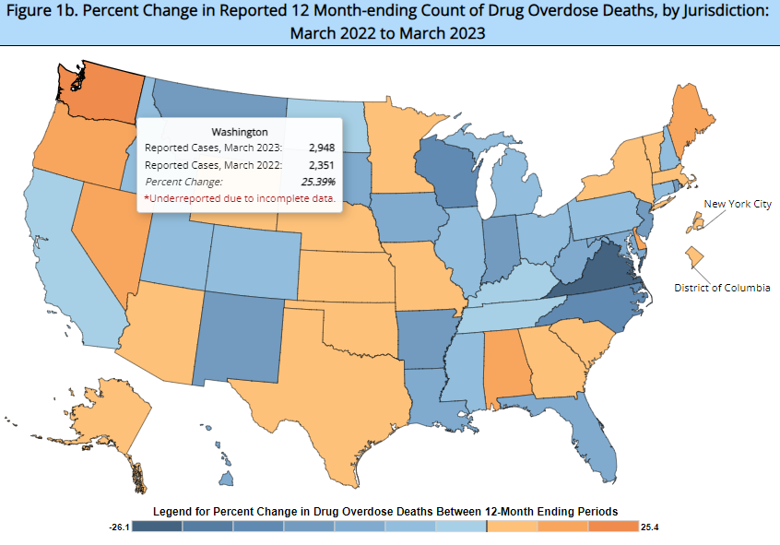
DOC Fentanyl Task Force
CDC reports WA had the highest year-over-year drug overdose death increase in the nation.

Slide 7
DOC Fentanyl Task Force
Mission: To design, develop, and implement multi-disciplinary strategies to combat the introduction and proliferation of fentanyl in the DOC population enterprise wide.
Education:
Training staff and incarcerated individuals about the prevalence and dangers of fentanyl.
Provide information about importance of reducing drug use stigma and supporting treatment.
Train staff to work safely and confidently in situations where they may encounter suspected fentanyl.
Treatment:
Qualified staff support treatment and recovery using substance use treatment based on evidence-based practices.
Explore options to increase awareness and innovation in our treatment options.
Enforcement:
Develop agency initiatives to combat the introduction and use of fentanyl and other synthetic opioids.
Collect information to identify vulnerable populations to inform opportunities to intercept illicit controlled substances.

